Slide 1
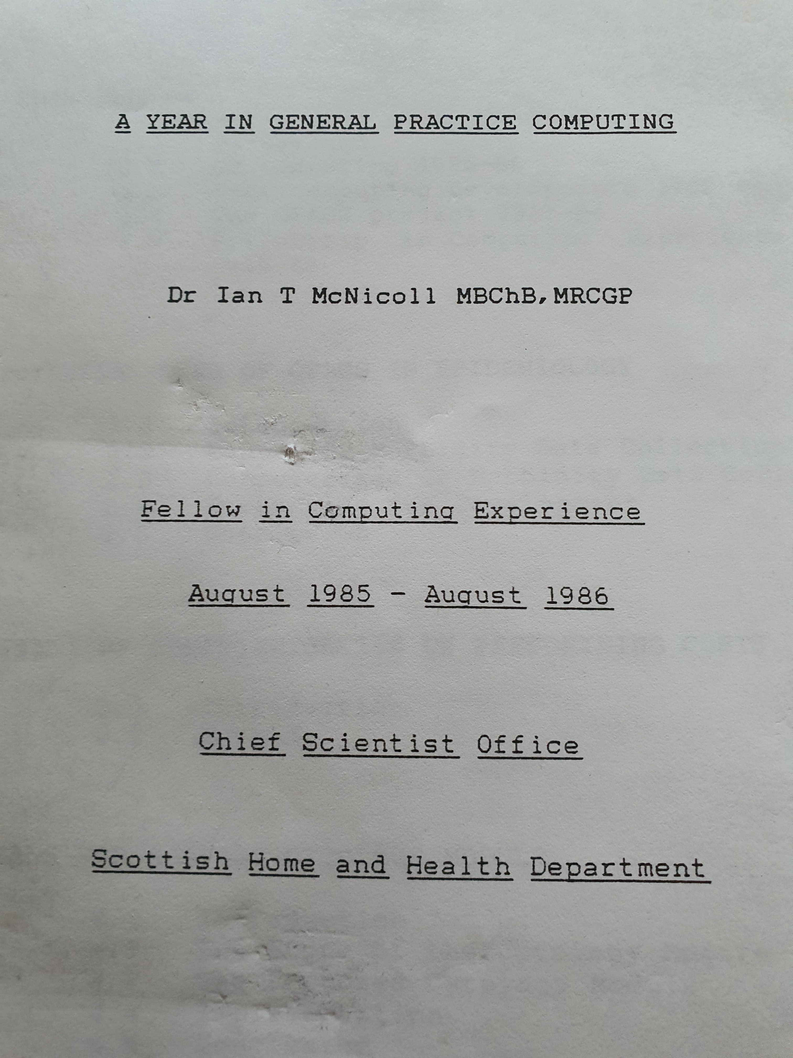

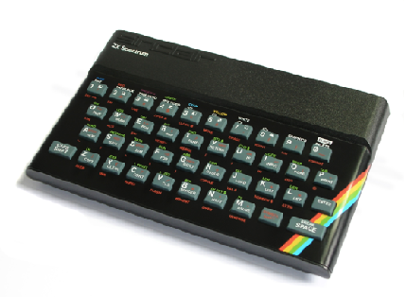


What is openEHR: Towards a coherent patient-centric digital healthcare ecosystem

Slide 2





What do we actually want ? A patient-centred coherent information system?
GP
Hospital
uro
GP
OOH

Slide 3
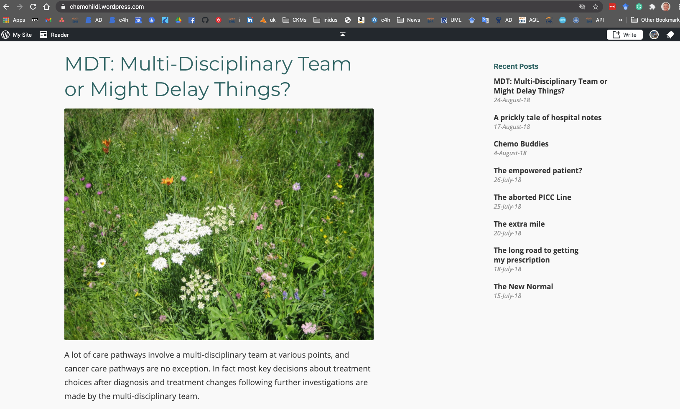
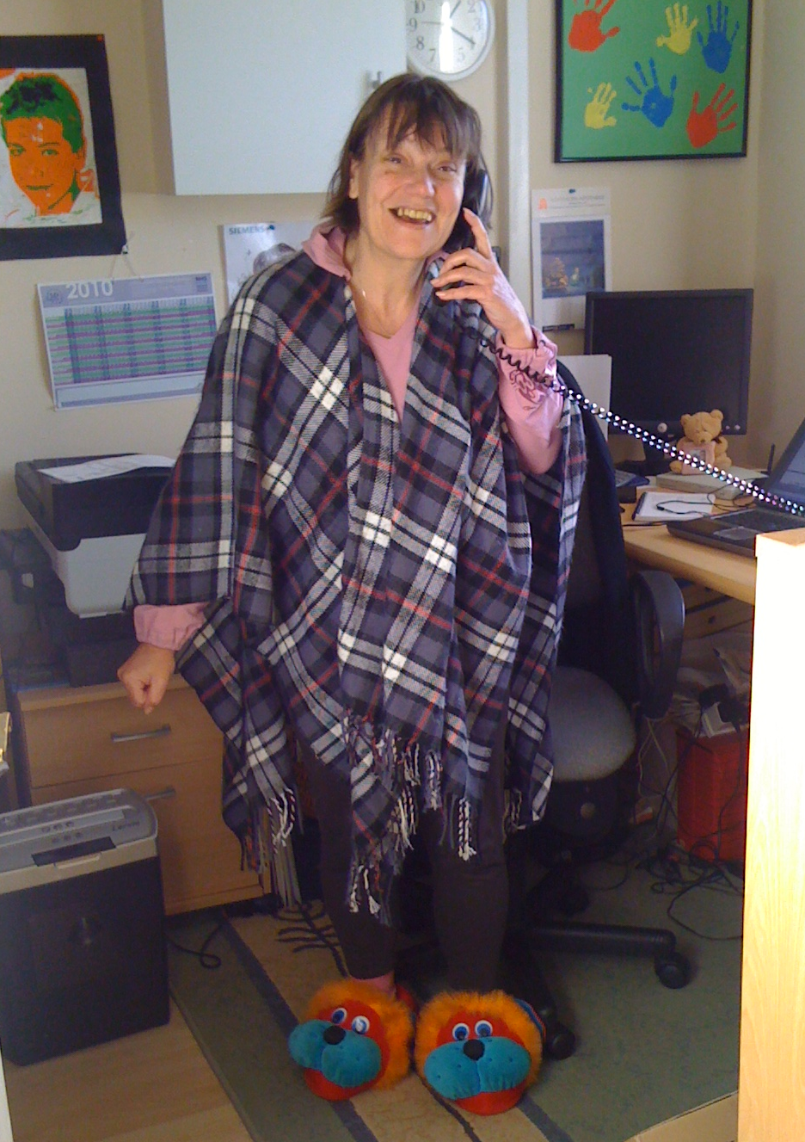
chemoHildi

Slide 4
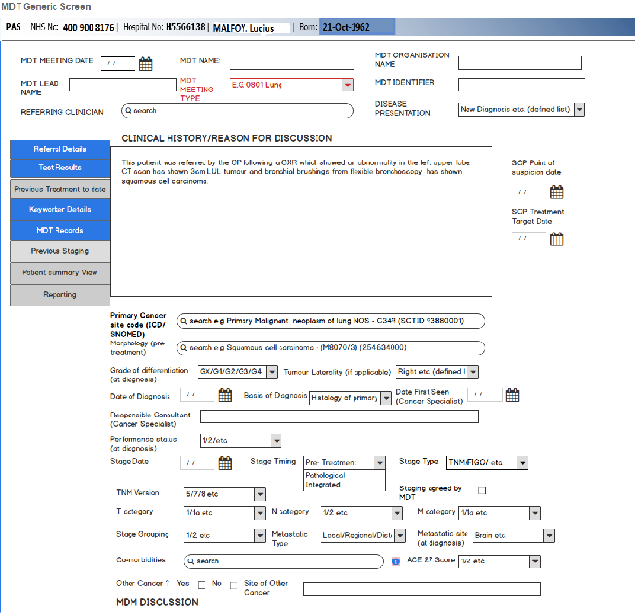

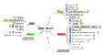

What is an ‘IT system’?
User interface
User interface
Information model
Information model
Database
Database

Slide 5
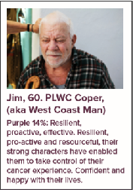
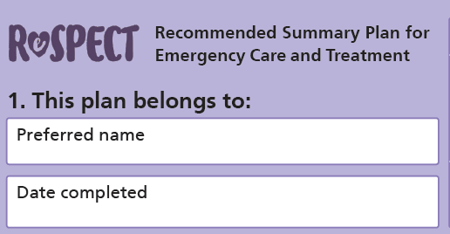
Cancer journey

Slide 6


A. One system to rule them all?
User interface
Information model
Database
with the patient at the heart

Slide 7


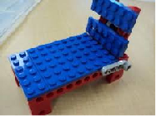




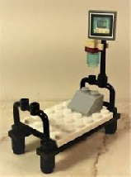
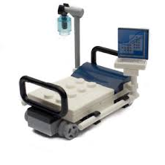



B. Best of Breed - ‘interoperability’

Slide 8
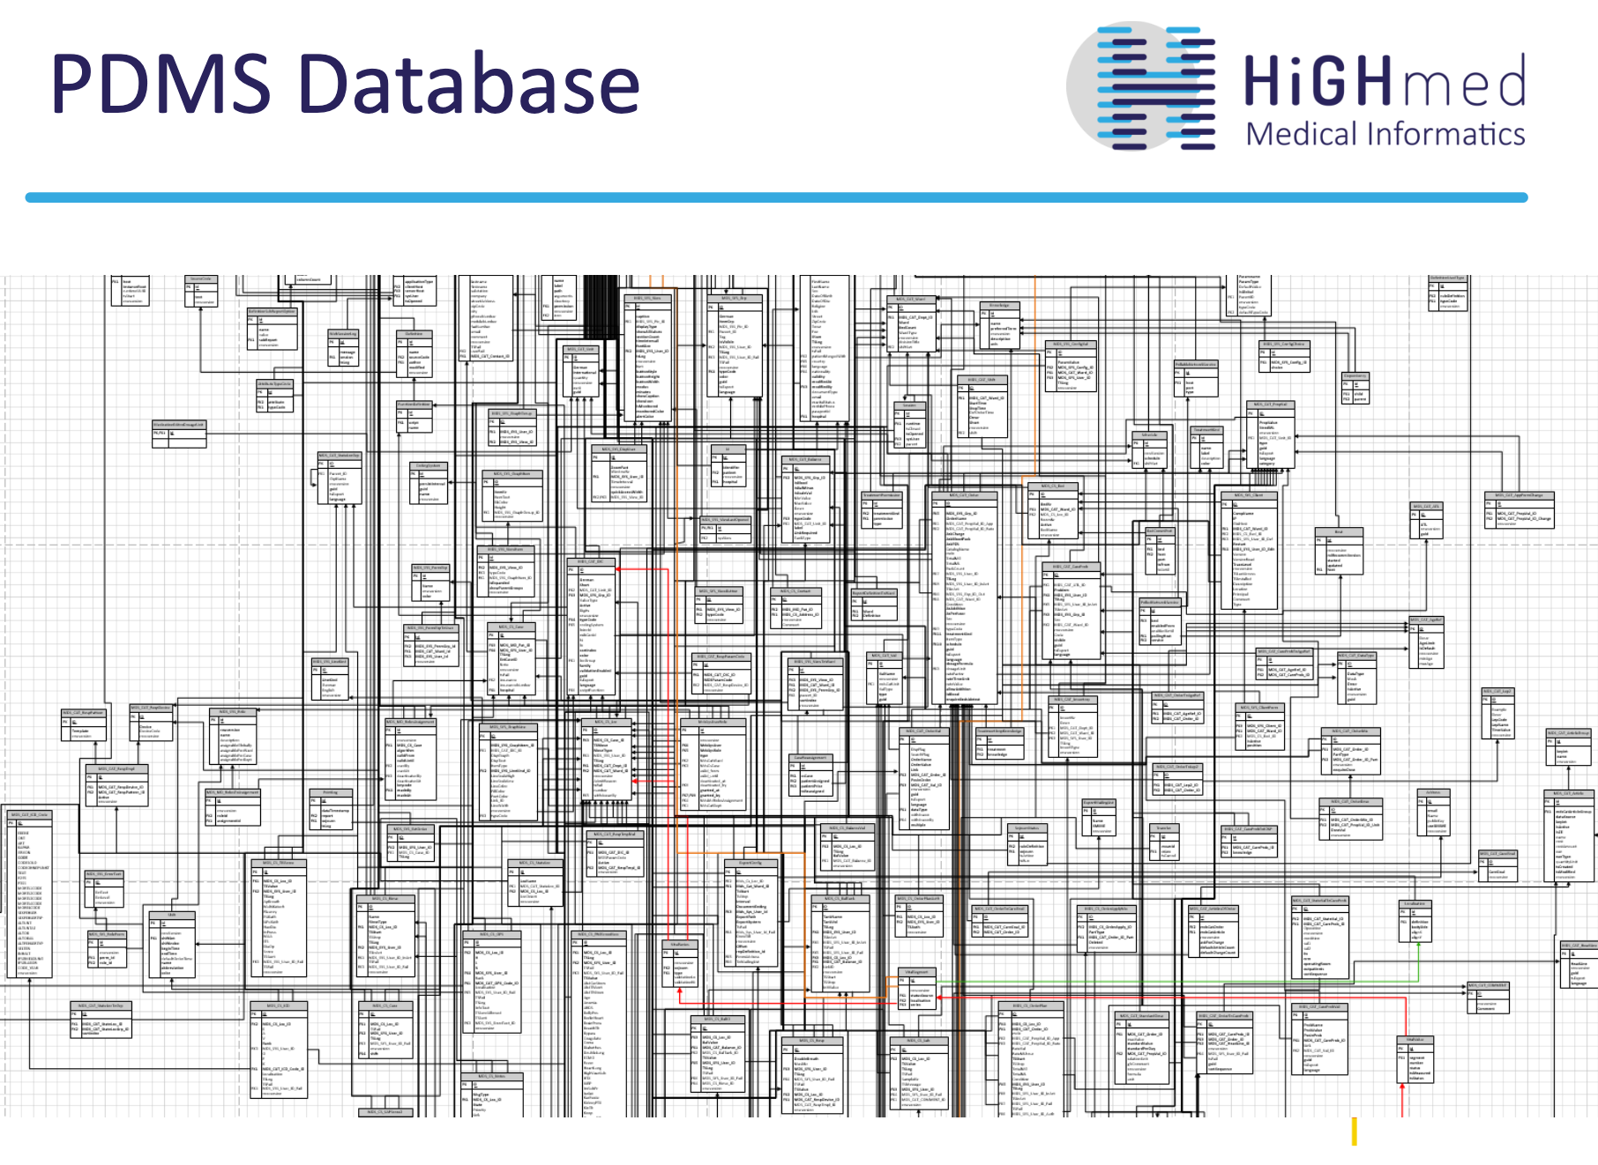
RDBMS - ‘so 20th century’?

Slide 9
Coherent Platform - single ‘system’/ ‘multiple apps’
Information model
Database

Slide 10
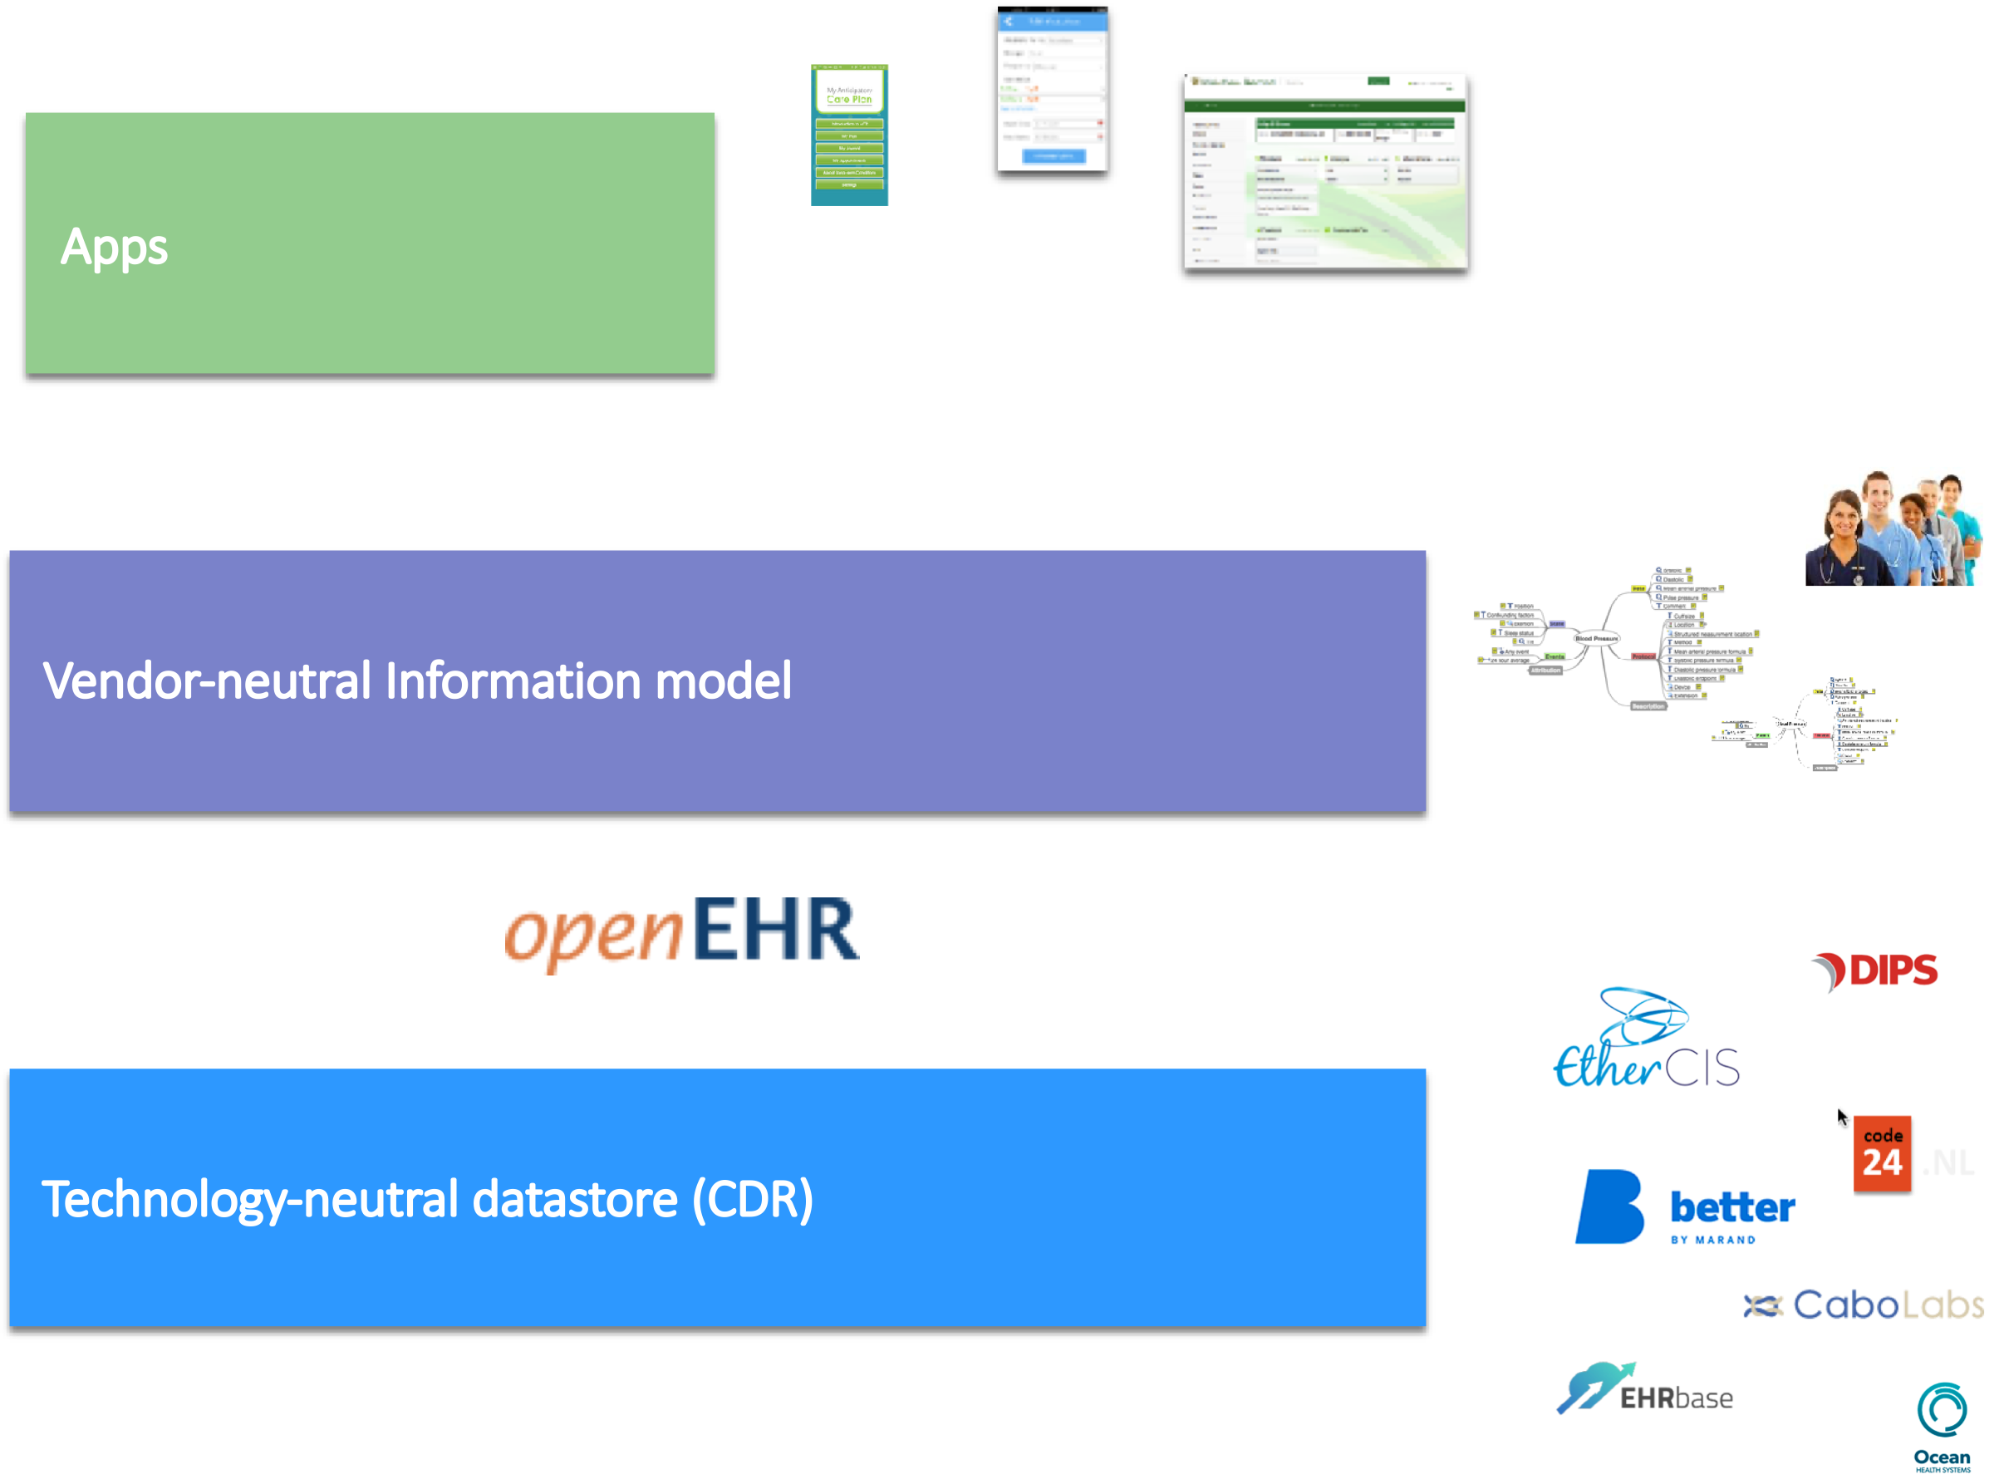
open Platform - vendor-neutral

Slide 11
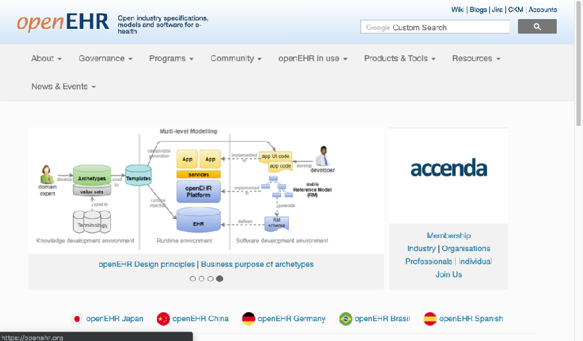
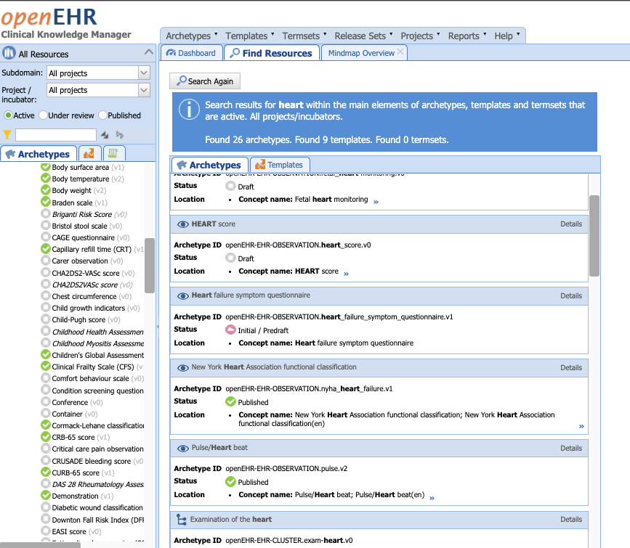

What is openEHR?
open specification for a health ‘information model’
supporting an open platform ecosystem
vendor /technology/license neutral
Non-profit ‘industry / clinical/ health organisation’ collaborative
openEHR International
openehr.org
specifications.openehr.org -specifications
ckm.openehr.org - clinical models

Slide 12
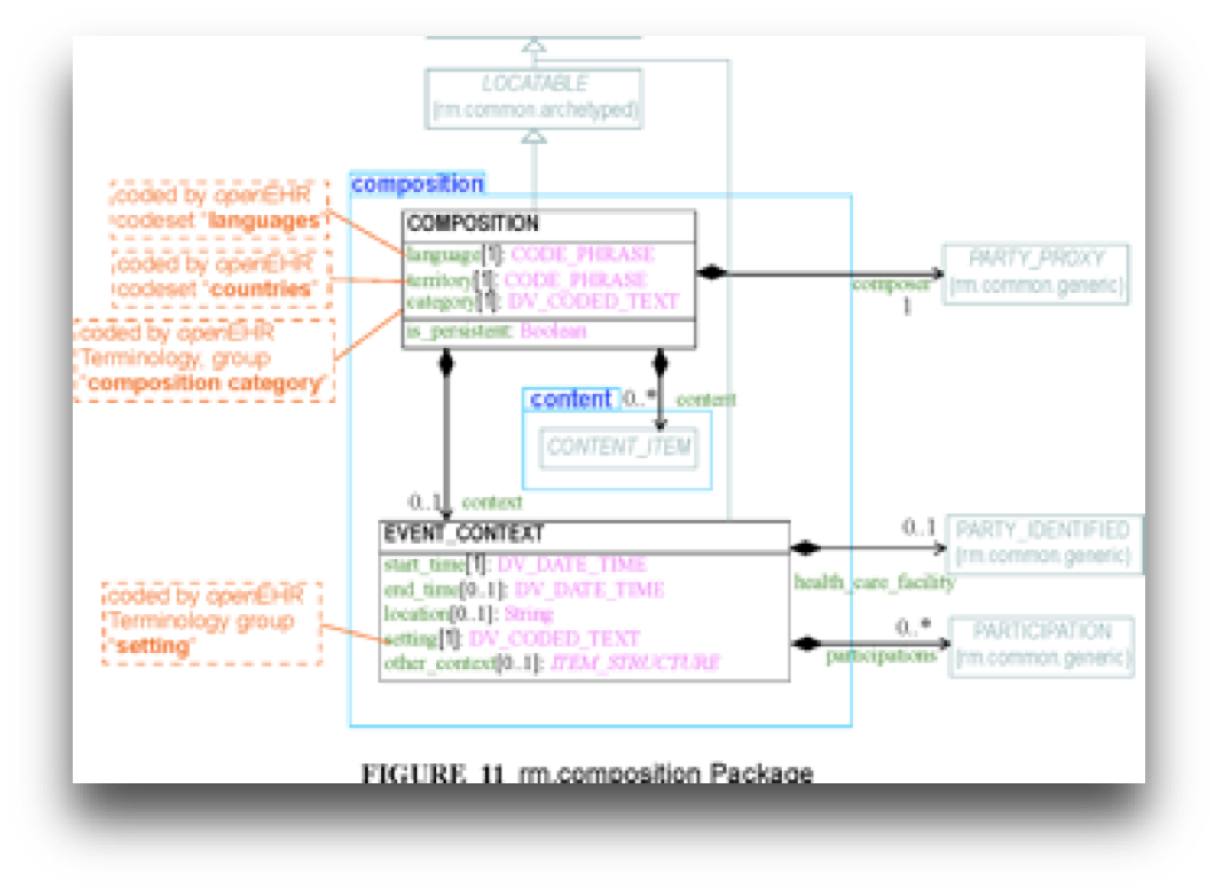
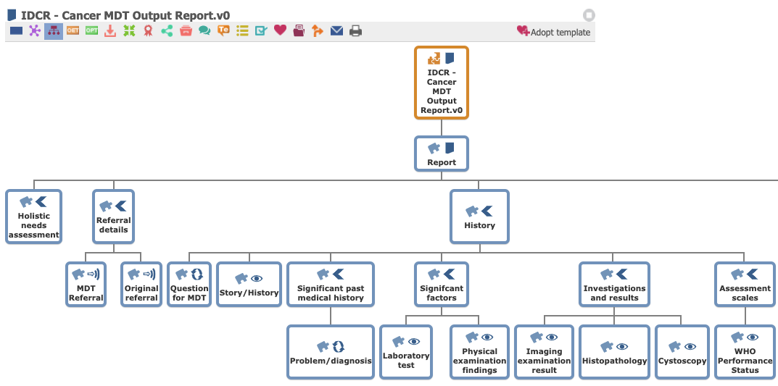
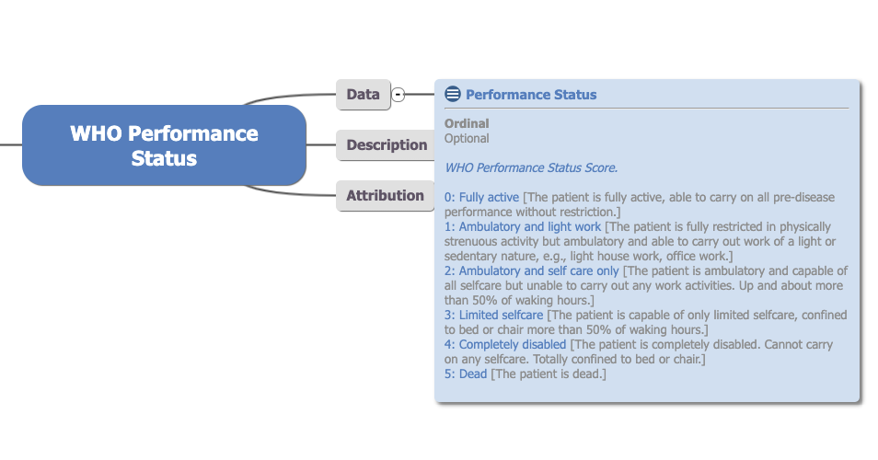
openEHR - vendor-neutral information model for persistence
Reference model
Templates
Archetypes

Slide 13
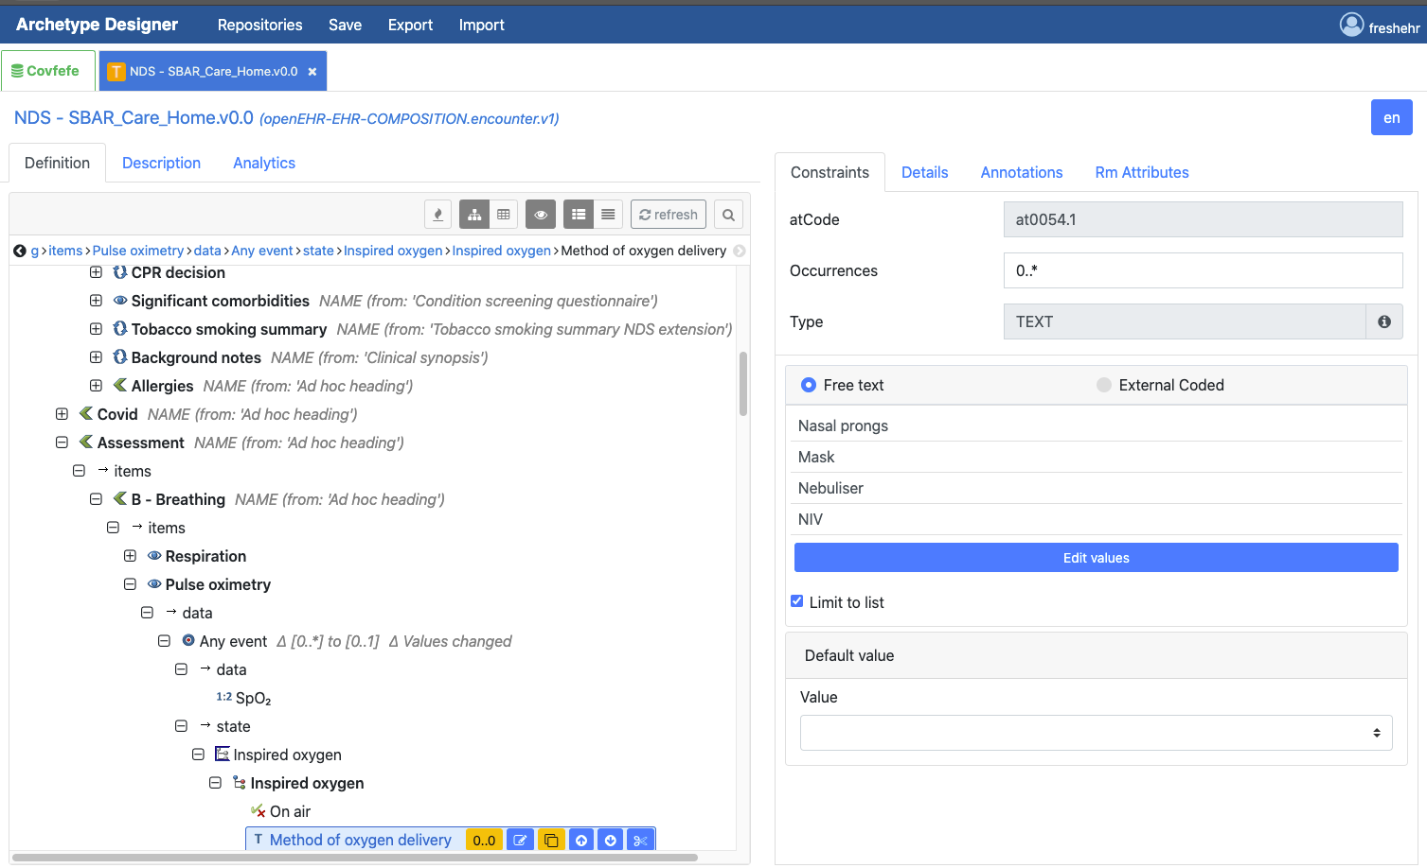
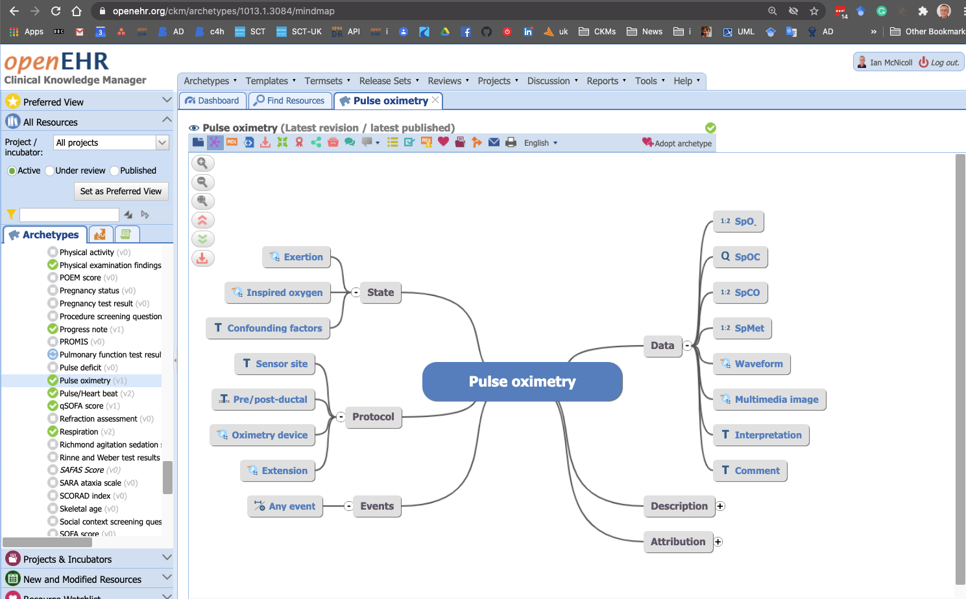
openEHR tooling
https://tools.openehr.org/
https://openehr.org/ckm

Slide 14
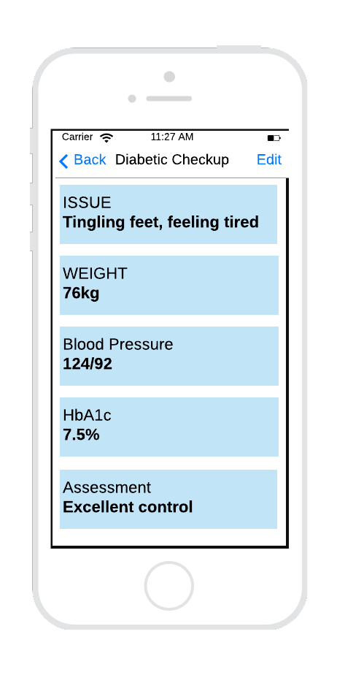
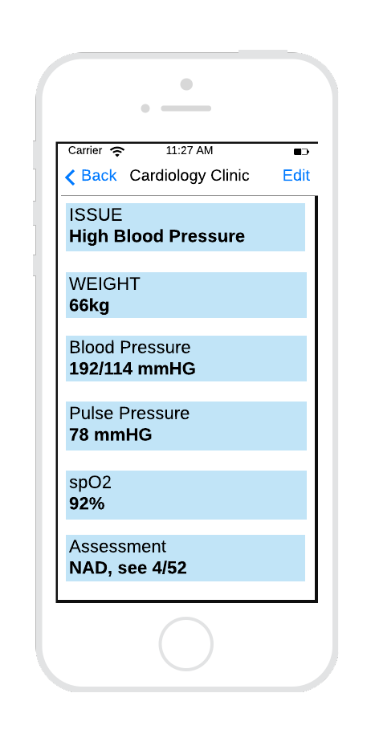
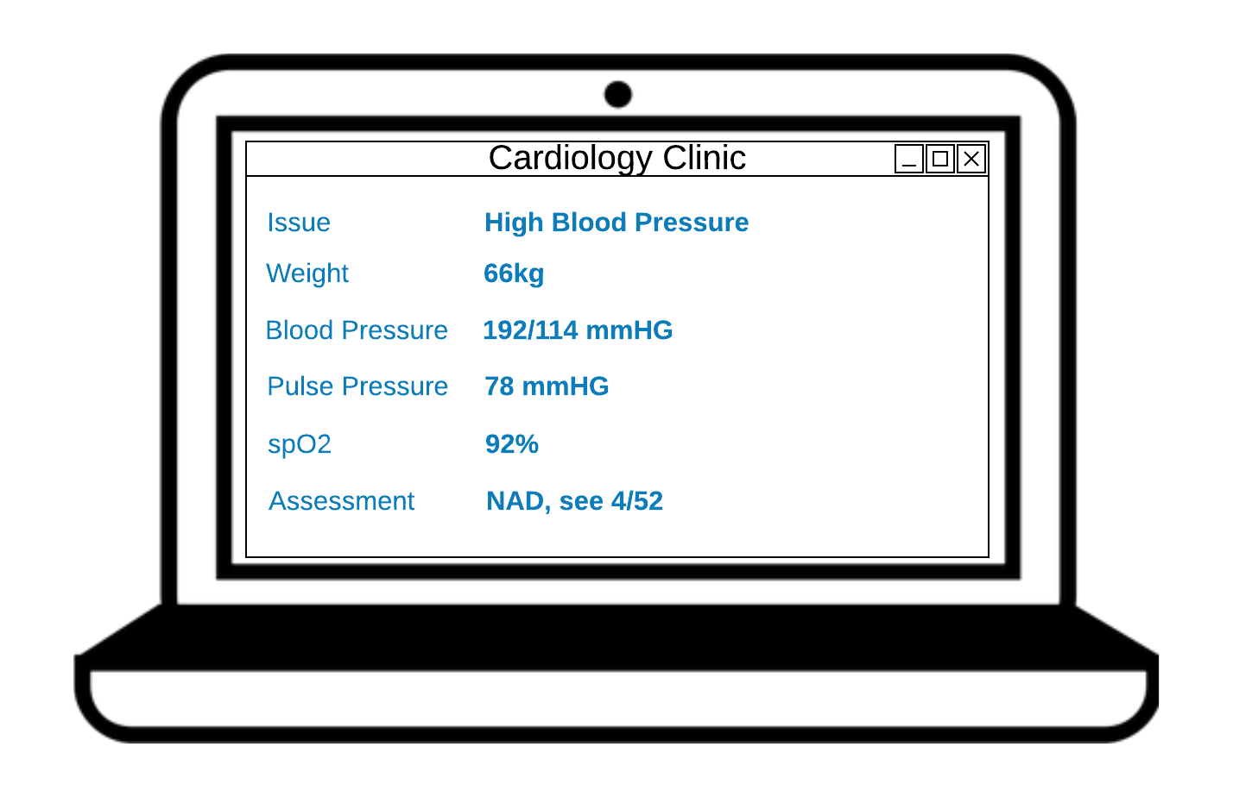
Archetypes and templates
Template underpinning application
Template underpinning application
Archetypes
used in template
Issue
Weight
Blood Pressure
HbA1c
Oximetry
Assessment

Slide 15
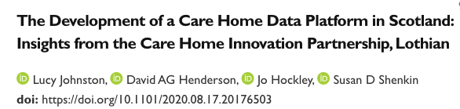
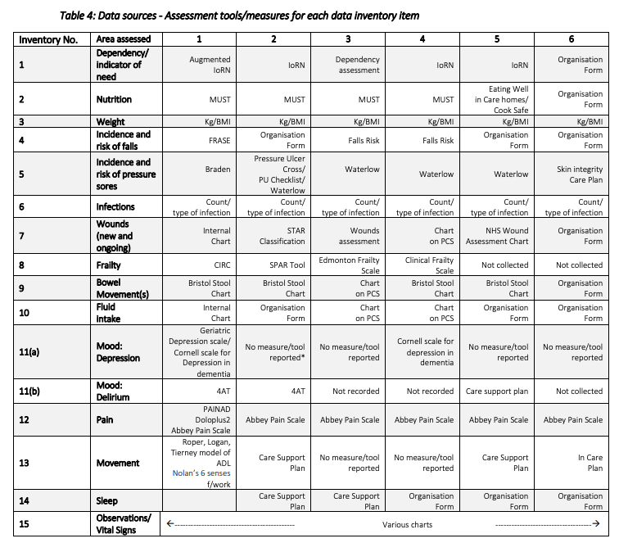
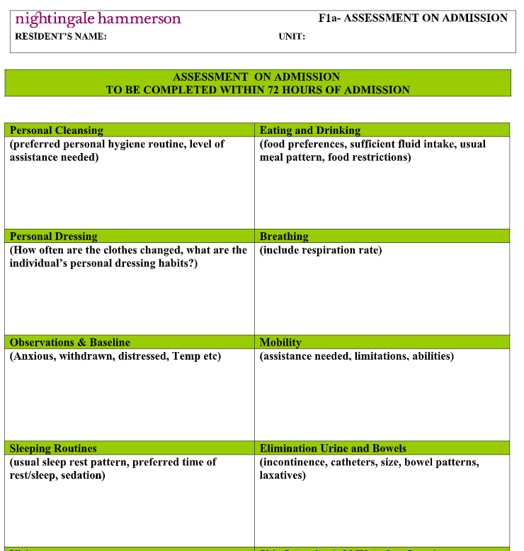
Discovery process
Care Home data standards?

Slide 16
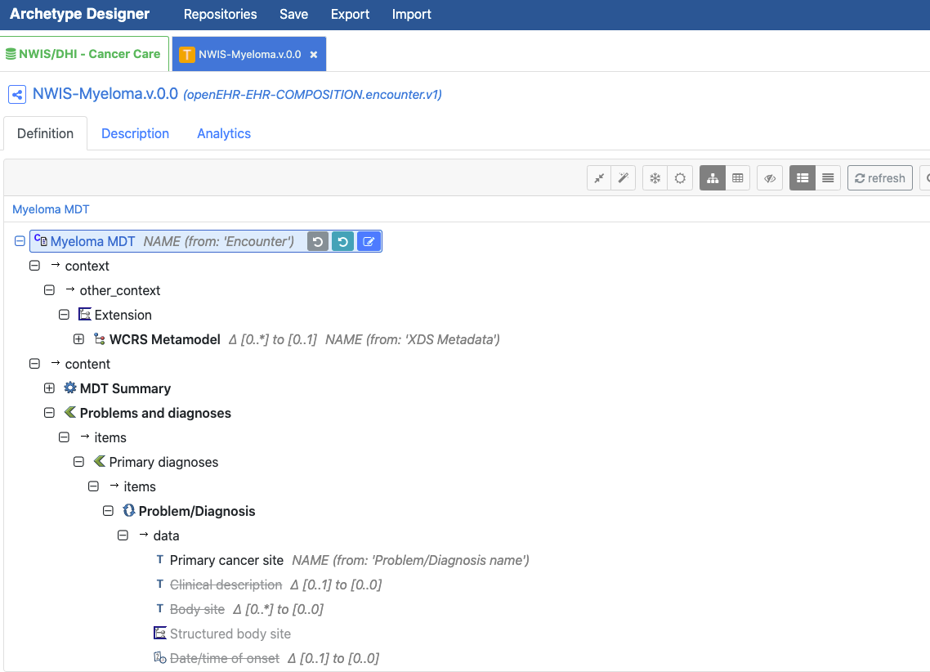
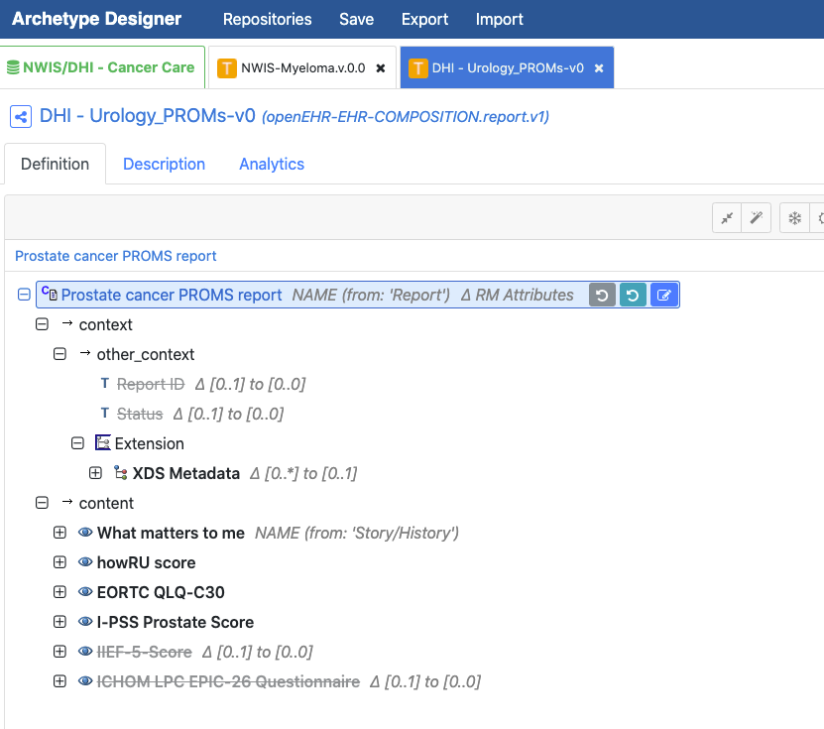
Cancer pathways / reporting - UK

Slide 17
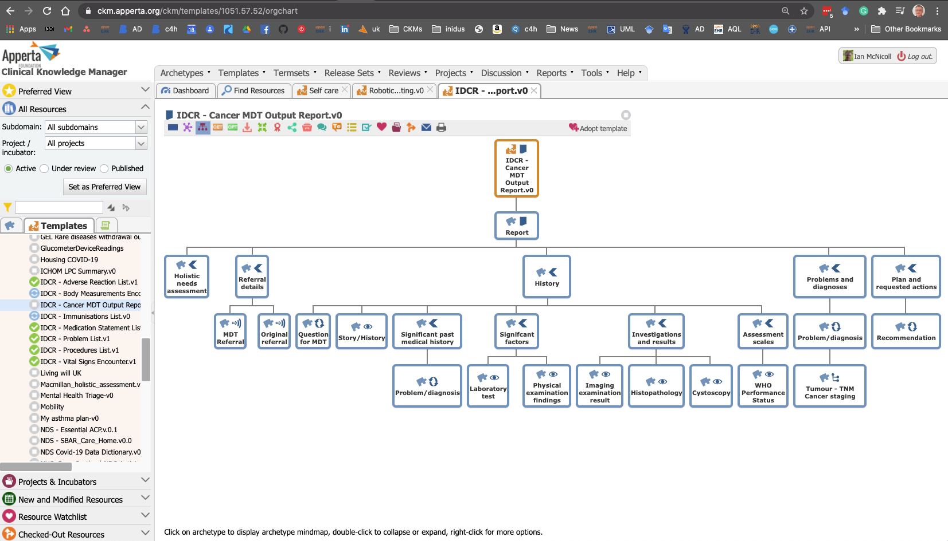
CKM - Collaborative review / publication

Slide 18


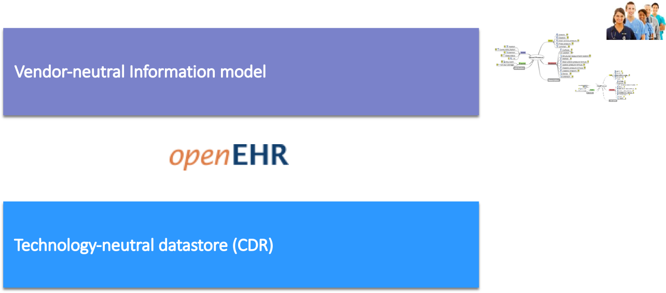
CDR - Clinical data repository
Smart datastore which natively stores, retrieves, queries openEHR data via a standard API
All data completely available
AQL - Vendor-neutral querying
‘No-code’ deployment of new clinical content definitions

Slide 19
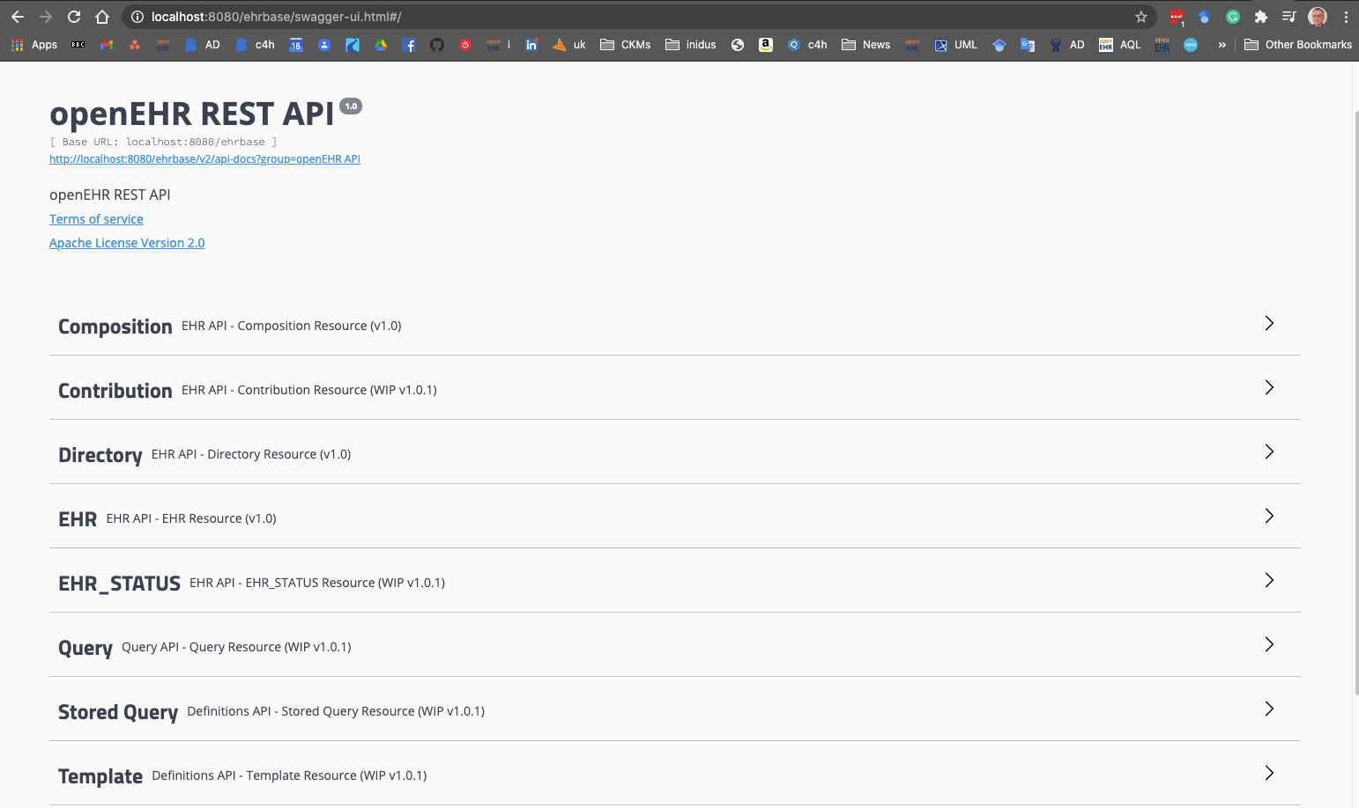
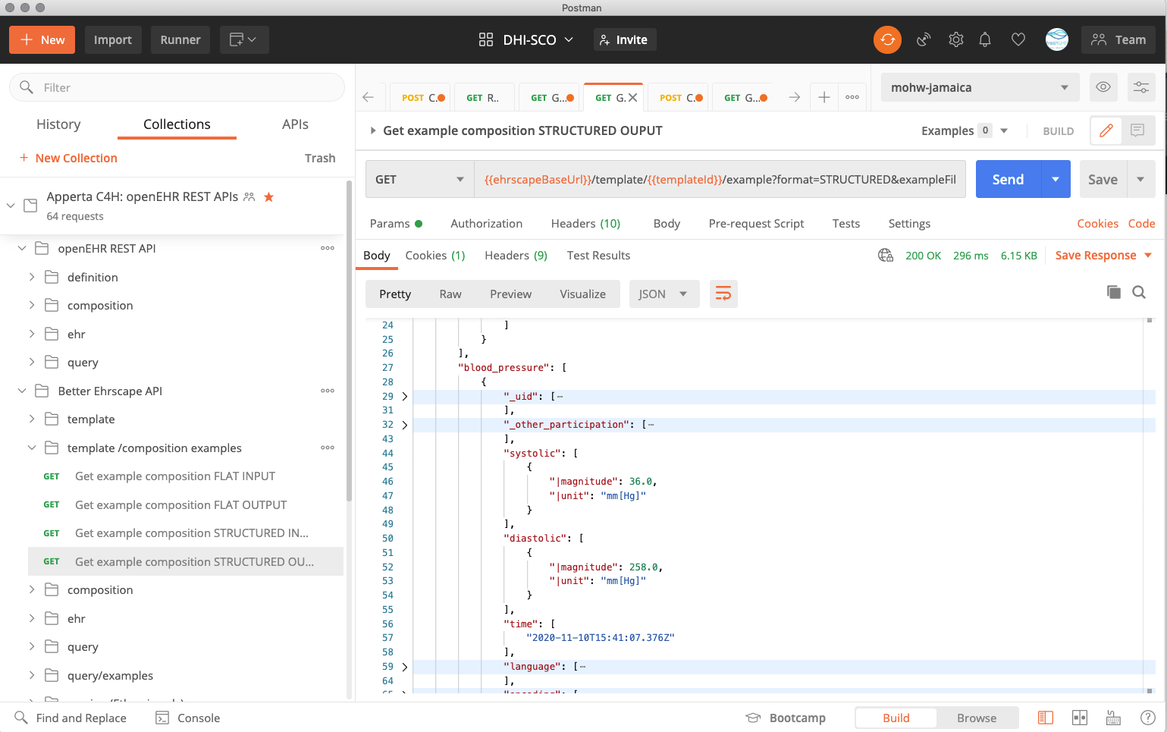
openEHR / ehrscape API

Slide 20
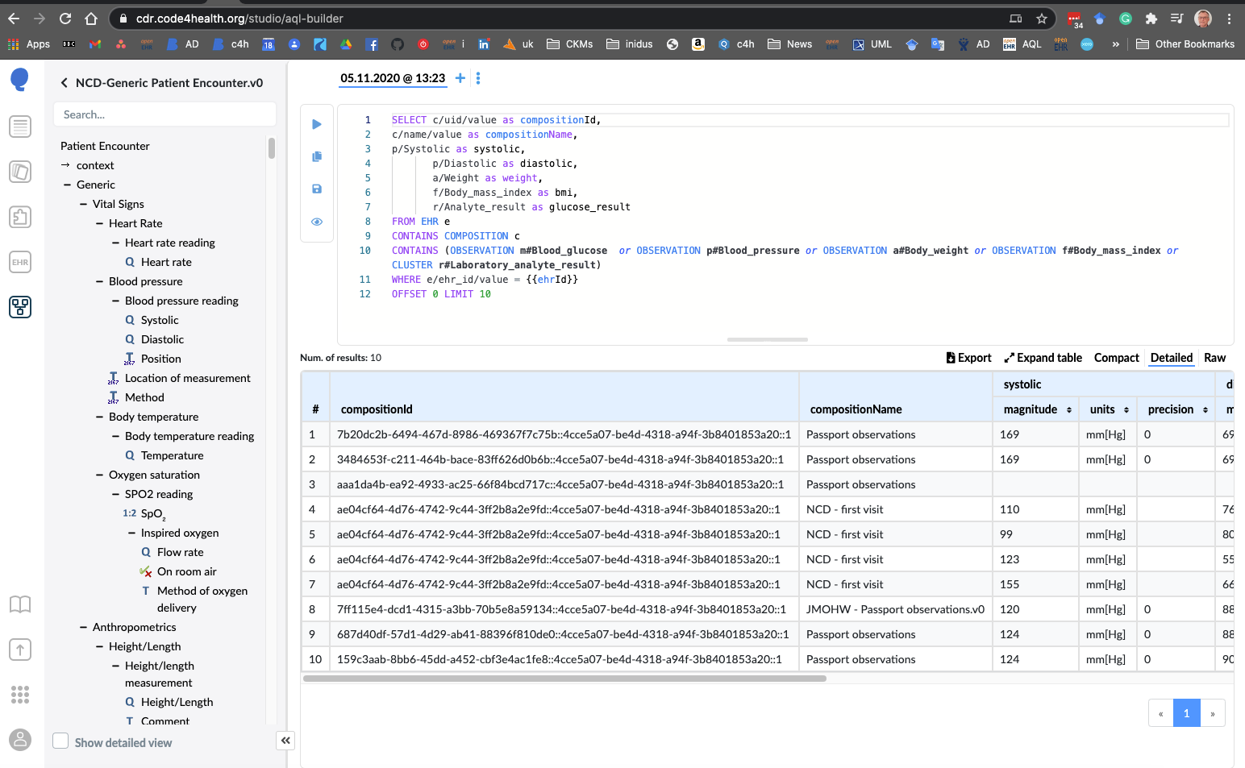
AQL - Archetype Query Language

Slide 21
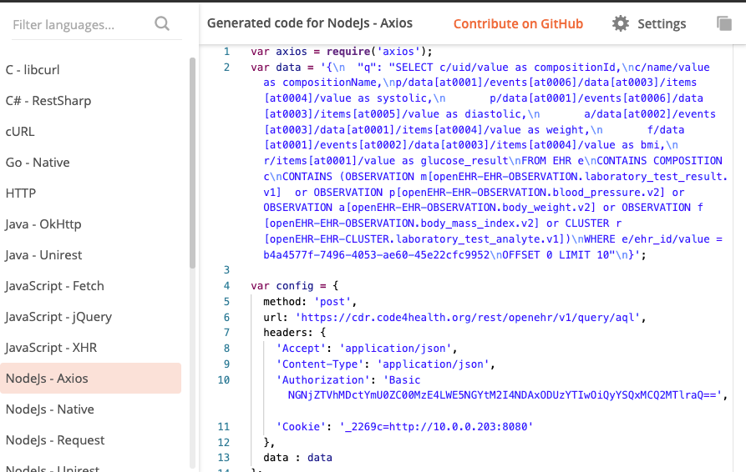
openEHR REST API /query

Slide 22
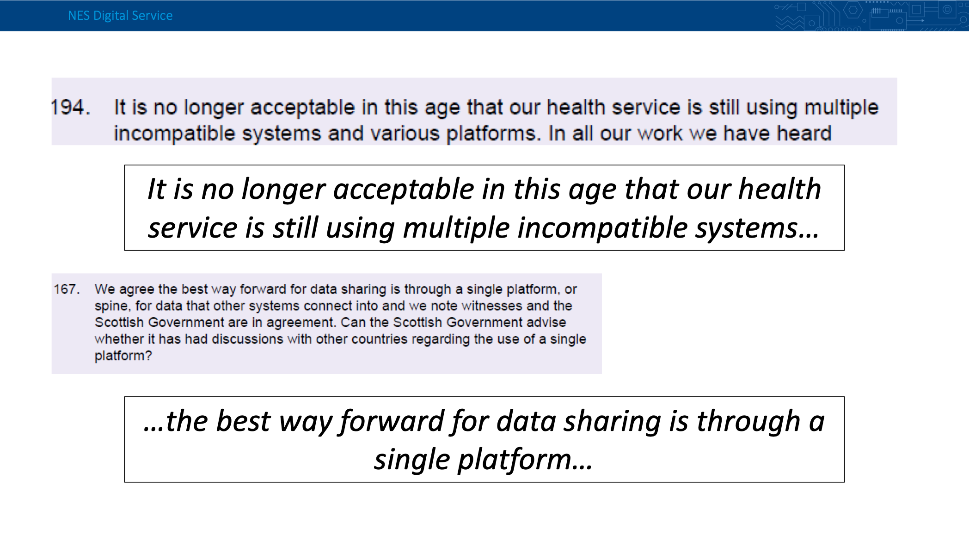
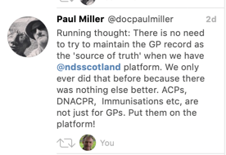
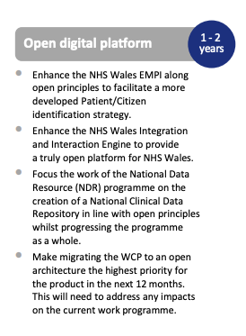
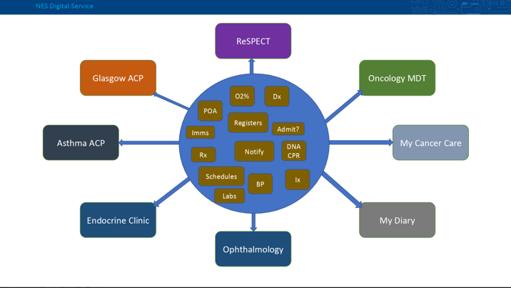
NHS Scotland: National Digital Platform

Slide 23


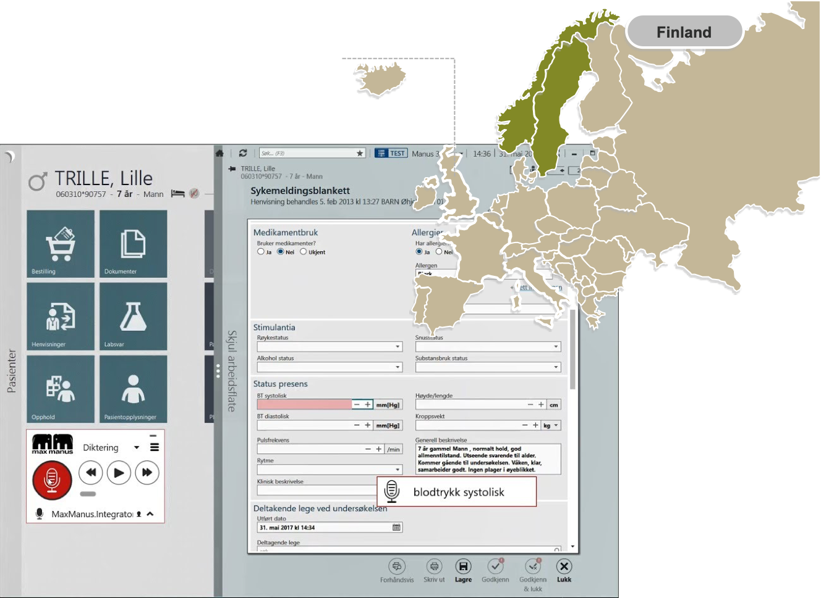
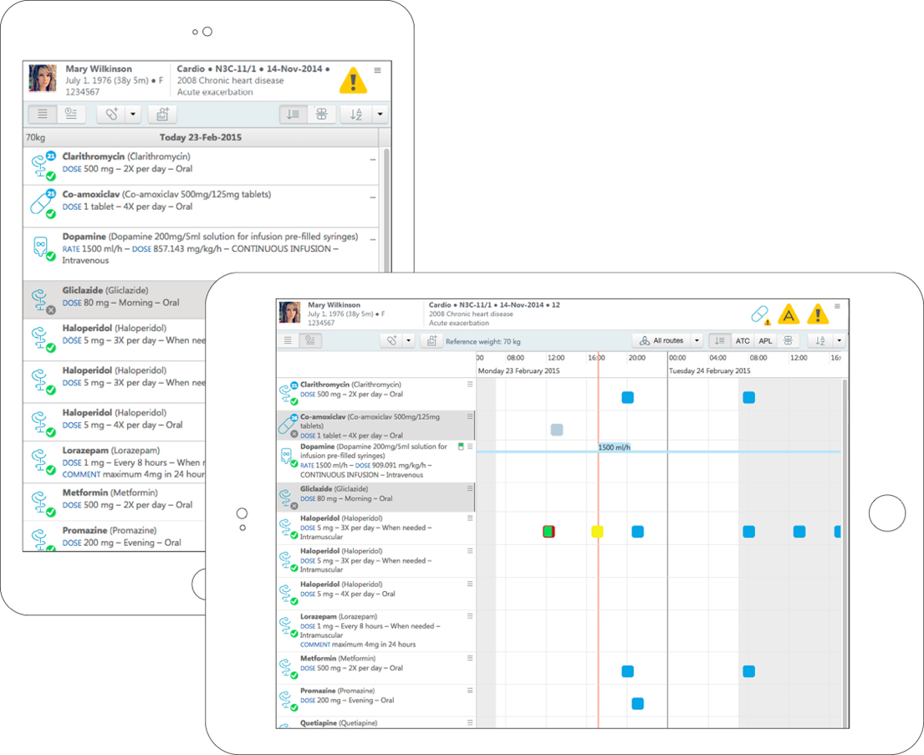
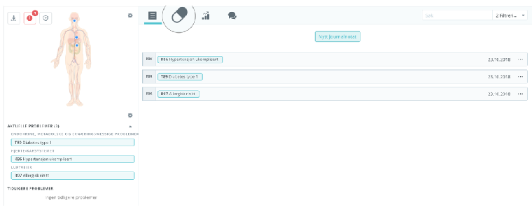
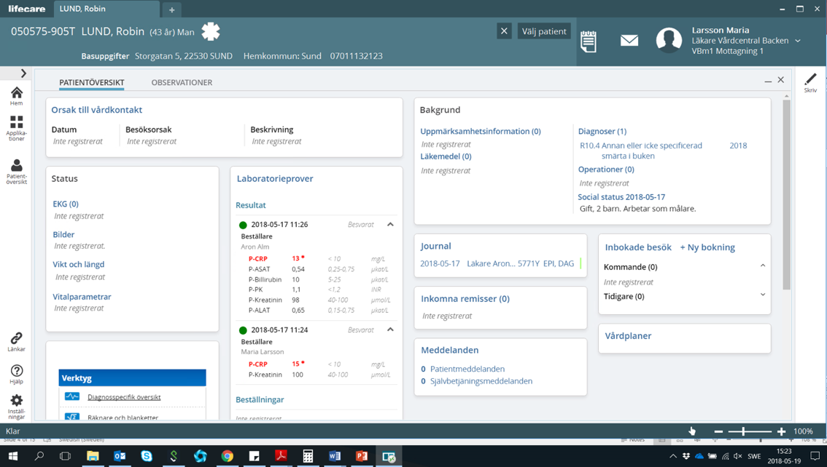

openEHR applications - at scale

Slide 24
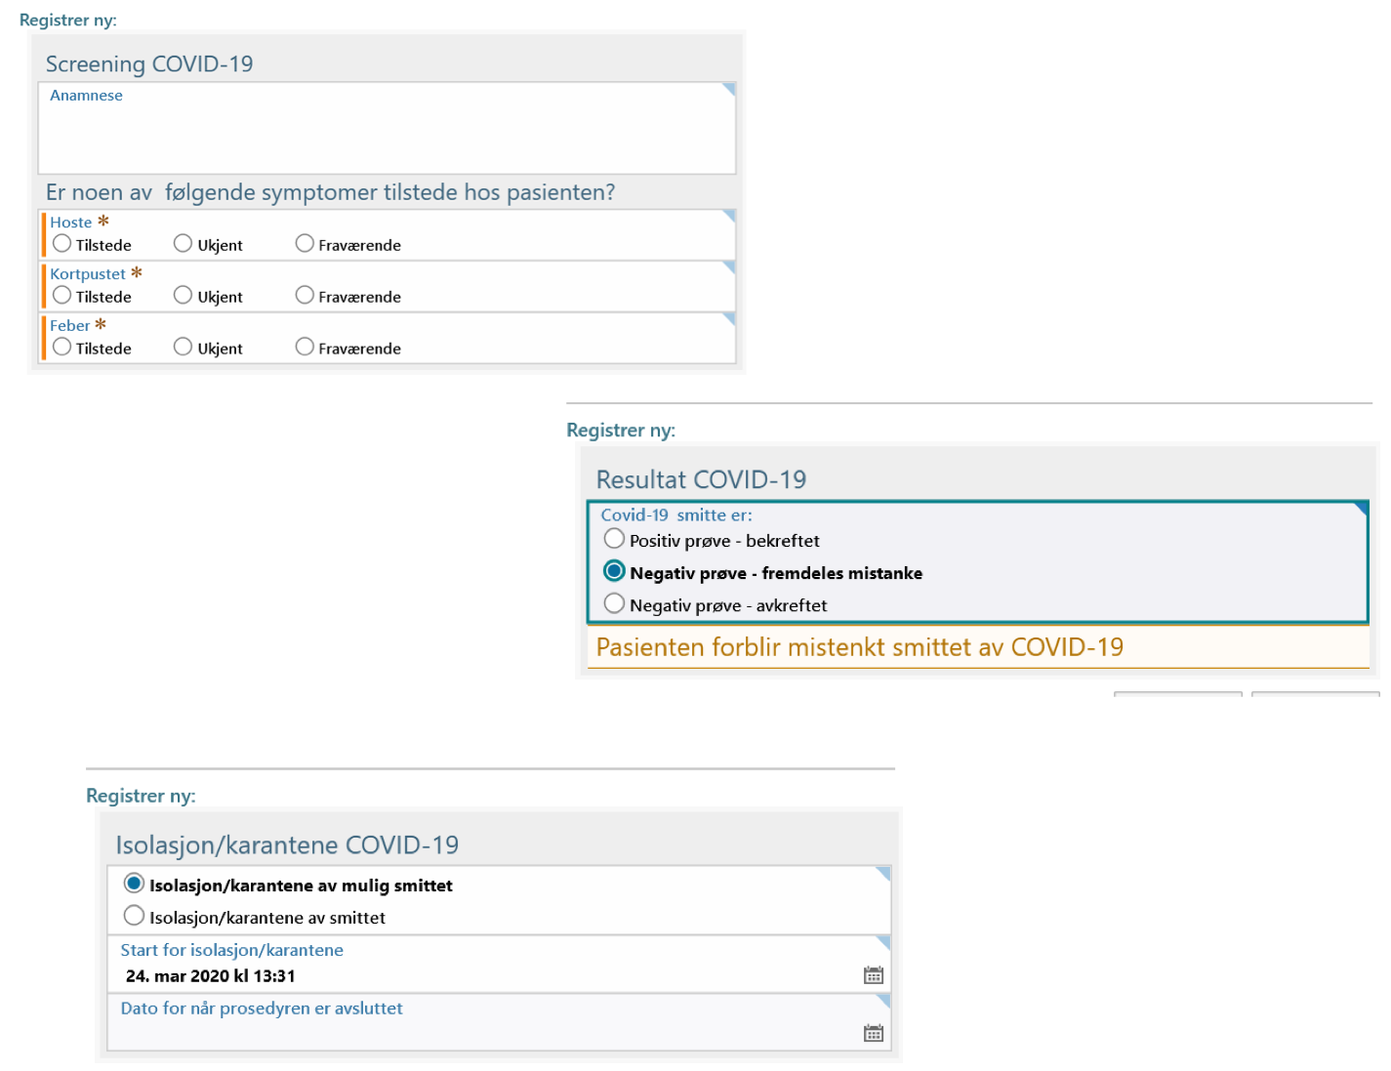
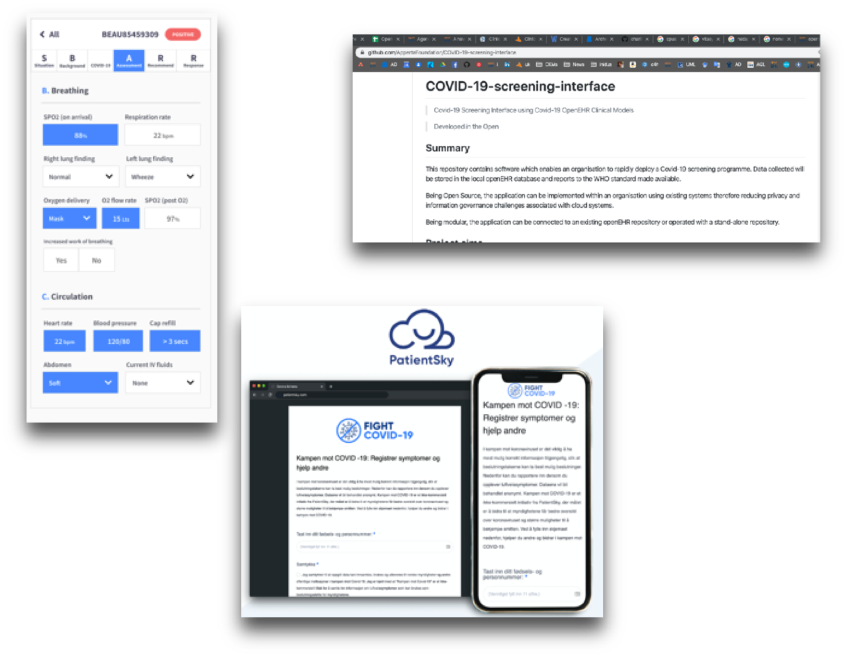
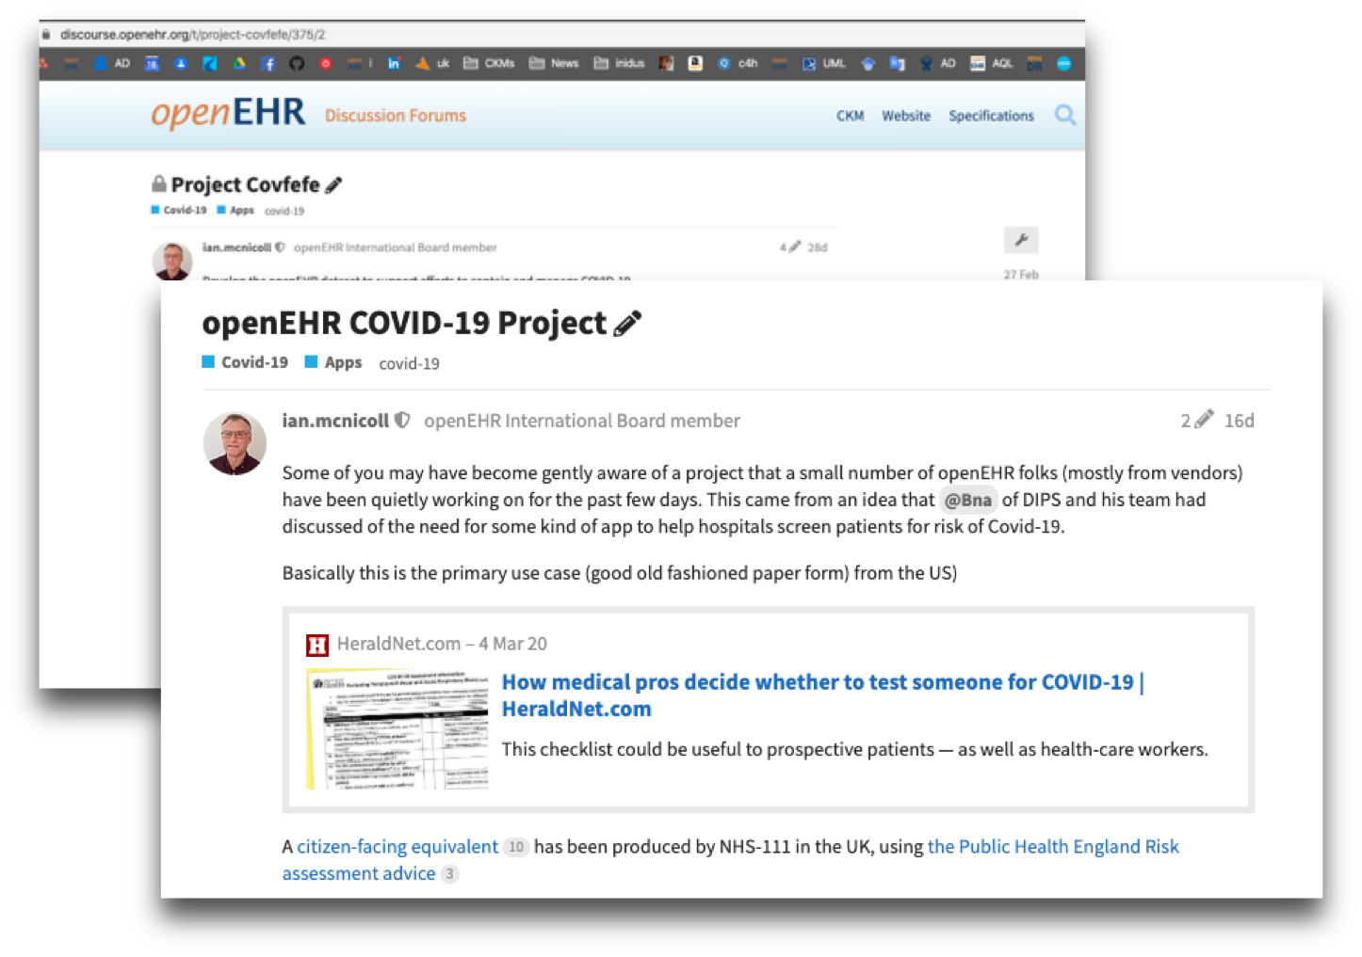
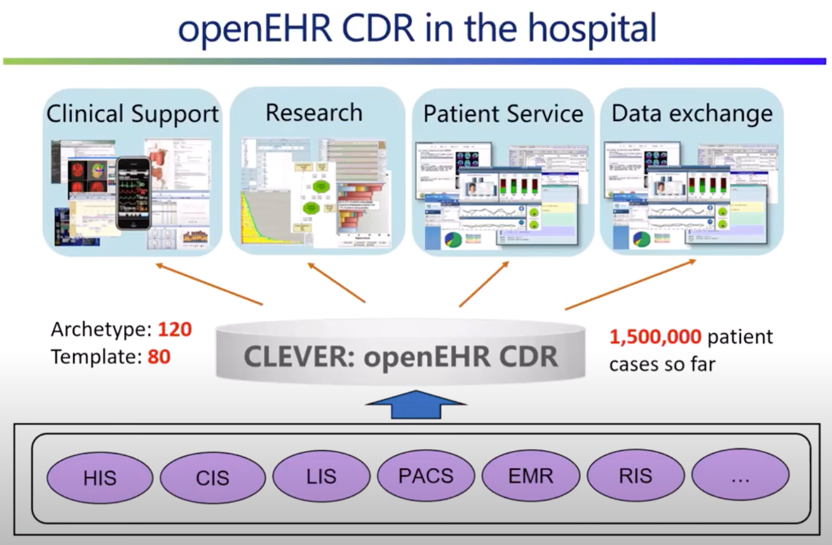
Covid-19
https://www.youtube.com/watch?v=oAzjHdiioDY&feature=youtu.be

Slide 25

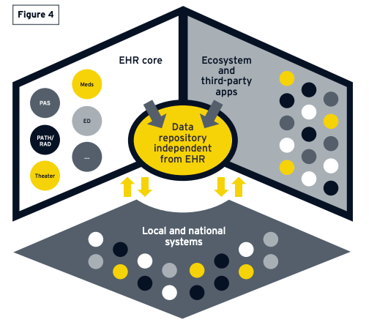

EY - connected Health ecosystem
https://assets.ey.com/content/dam/ey-sites/ey-com/en_gl/topics/health/ey-global-health-tech.pdf

Slide 26
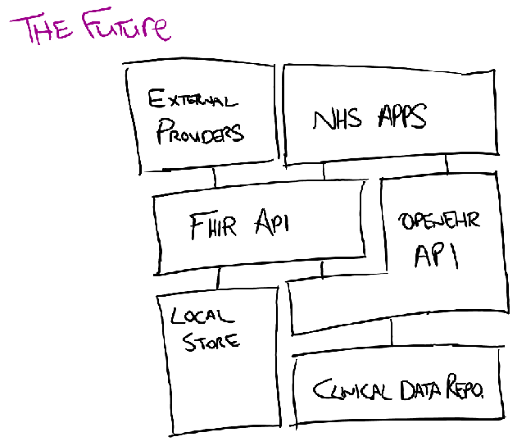
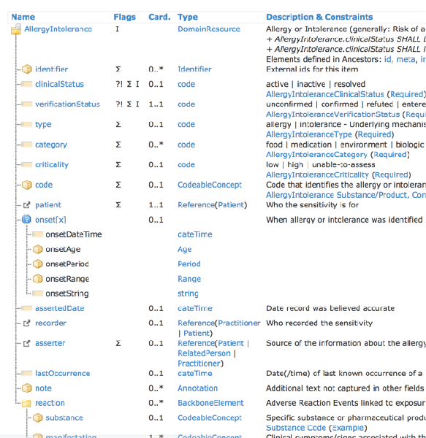
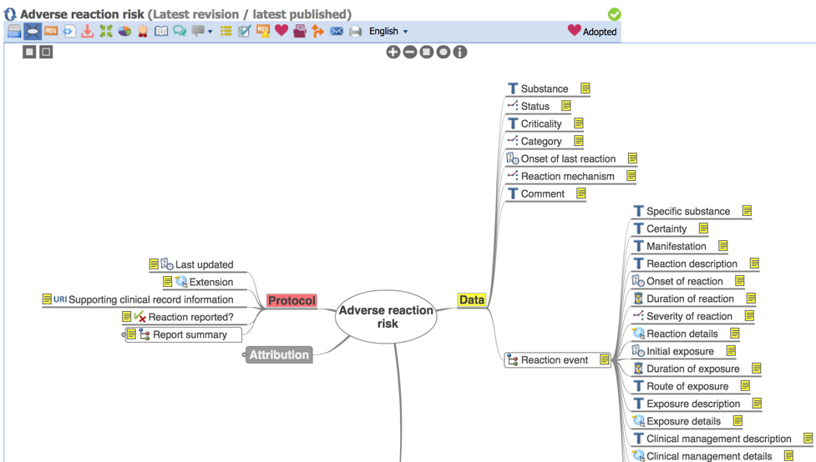

Why not ‘just’ use FHIR?
https://www.interopen.org/wp-content/uploads/2019/03/INTEROPen-openEHR-and-FHIR_March2019.pdf

Slide 27

openEHR vs + FHIR
FHIR has had a significant positive global impact in helping existing systems exchange high-value clinical information, in a modern developer-friendly way along with other helpful innovations such as vendor-neutral terminology service interfaces.
The openEHR development community is actively adopting FHIR standards, over openEHR-based datastores and tooling, in line with other more traditionally engineered systems, using FHIR ‘as intended’, to support information exchange between applications..
In contrast, openEHR supports a world where applications increasingly coalesce around communal, vendor-neutral structured data repositories (CDRs).
The ‘controller’ of the CDR (not the vendor) can upload new openEHR clinical model definitions without further engineering or recourse to the vendor and patient records can then immediately be created and fully-queried using those new definitions - a ‘no-code’ vendor-neutral data management environment.
Alastair Allen, CTO Kainos: The case for using FHIR and openEHR
https://www.youtube.com/watch?v=biEXVRzjWmw

Slide 28




Why not ‘just’ use SNOMED CT?

Slide 29
openEHR - rewiring healthIT:
From ‘my system’ to a person-centric information system
separate the data from applications
single source-of-truth where that makes sense
but federate if needs be
open platforms / vendor & tech-neutral information standards
Standardisation by negotiation not by science, clinically-driven
The near future is openEHR + SNOMED CT + FHIR

Slide 30
openEHR and Secondary uses
Ian McNicoll

Slide 31

AQL: Archetype Query Language

Slide 32
openEHR Reporting
Reporting AQL => CSV
SELECT * FROM Patients;
CDR
“ETL”
Analytics DB

Slide 33
Discovery process
Care Home data standards?

Slide 34
The current UK openEHR CDR installations/projects that I am aware of are ..
BetterCare:
Plymouth hospital
Somerset FT including the merger with community and Mental health
Wye Valley FT
Dartford and Gravesham FT
South London and Maudsley mental health Trust
Oxford Mental Health Trust
South Tees hospital FT
Salford FT
15 hospitals within the Cancer Alliance (implementing) - Cancer MDT pathways
North Thames and West midlands NHS genomics medicine centres - full Cancer and Rare disease genomics phenotypics
NWIS - proof of concept - Cardiology, Cancer, community medication record
Digital Health and Care Institute Scotland - sandbox open platform environment
N. Ireland Genomics platform
most of these are based around the Better EPMA product but several of the trusts involved have already started building their own apps on the CDR or integrating 3rd party apps.
EhrBase (open-source):
NHS Scotland National Digital platform - ReSPECT form, Vaccination records? ophthalmology pathways?, Cancer Treatment summaries
opusVL /Apperta Care home Covid assessment app
opusVL /Apperta Ward eObs app
Staircase13 / Apperta 'Chart my health' mental health PHR app https://vimeo.com/463452989
Staircase 13 / Apperta - open Outcomes Ortho PROMS app
The UK openEHR community are also looking forward to playing a part in the upcoming INTEROpen hackathon on care planning, based on some prototypes for the East Accord LHRCE around End of Life care frailty and long covid management.

Slide 35


From frontline to analytics
Frontline data formats ⇏ analytics/research/registry formats
open vs. closed questions
questionnaires
“Diagnosis”: Diabetes
“Diabetes” : “yes”;”no”
AORTIS
Feblowitz: Summarization of clinical information: a conceptual model
Need for quality curation

Slide 36





100K Genomics: “Duration of HRT”
“Climesse”
“HRT”

Slide 37

openEHR International : openehr.org

